Slide 1
CAPSTONE ANALYSIS-SPEED DATING STUDY
Objective: To develop a predictive model for dating matches based on participant characteristics and preferences.

Slide 2
Objective:
To develop a predictive model for dating matches based on participant characteristics and preferences.
Data Utilized: Use participant characteristics and preferences from the speed dating dataset from Columbia University.
Methodology: Implement statistical and machine learning techniques to identify factors that significantly predict a match.
Focus Variables: Attributes like age, gender, interests, preferences in a partner, and self-perception metrics.

Slide 3
Value case for public authorities, companies, citizens
Public Authorities
Social Integration and Community Building: Insights can be used to foster community events and social integration programs, especially in diverse societies.
Public Health and Well-being: Understanding relationship dynamics can aid in designing public health campaigns and mental well-being initiatives.
Companies
Dating Services and Apps: Direct application in improving matchmaking algorithms.
Marketing and Advertising: Insights into preferences and behaviors can guide targeted marketing strategies.
Citizens
Improved Dating Experiences: Insights can help individuals understand factors that might lead to successful relationships.
Self-awareness and Development: Encourages reflection on personal preferences and behaviors in social contexts.

Slide 4
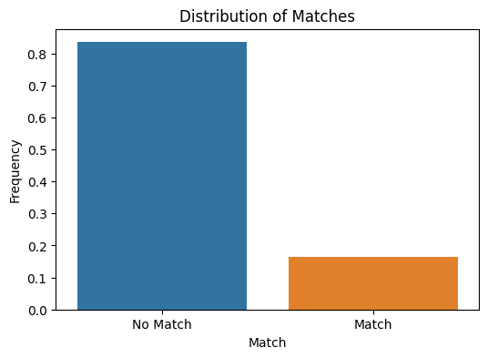
Match Distribution:
The majority of speed dating encounters did not result in a match.
This indicates that matches are relatively rare, which is an important factor to consider in model development.

Slide 5
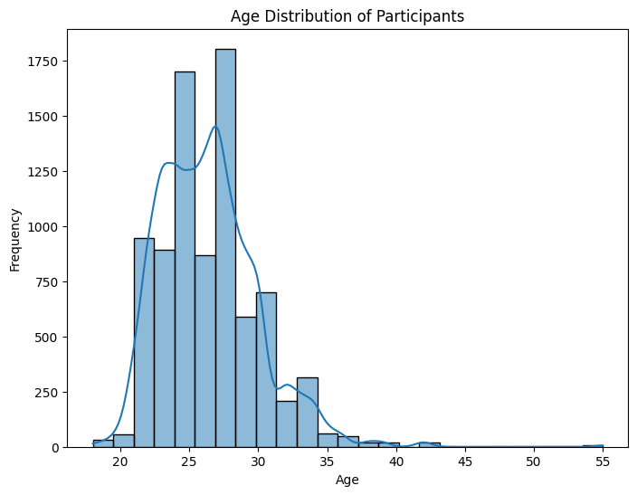
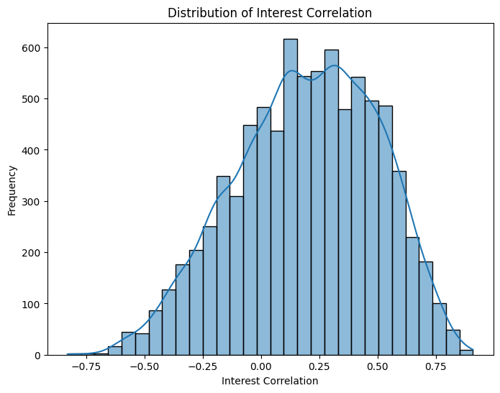
Age Distribution:
The age distribution appears to be skewed towards younger participants.
Most participants are in their 20s to early 30s.
Interest Correlation (int_corr) Distribution:
The interest correlation between participants varies widely.
Most values are clustered around 0, indicating a mix of positive, negative, and no correlation in interests.

Slide 6
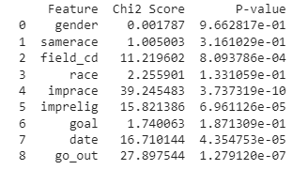
Features like 'imprace', 'imprelig', 'date', and 'go_out' show significant p-values (below 0.05), suggesting that they might be statistically significant predictors of a 'match'.
'field_cd' also shows potential as a significant predictor with a p-value below 0.05.
Features like 'gender', 'samerace', 'race', and 'goal', on the other hand, have higher p-values, indicating they might not be as significant in predicting the outcome of a match.
Significant variables

Slide 7
Regression
Classification Report:
Precision for non-matches (0) is 0.84 and for matches (1) is 0.40.
Recall for non-matches is 0.97 and for matches is 0.09.
The f1-score for non-matches is 0.90 and for matches is 0.15.
The overall accuracy of the model is approximately 82.06%.
Confusion Matrix:
The model correctly predicted 1109 non-matches and 21 matches.
It incorrectly predicted 32 as matches (which were non-matches) and 215 as non-matches (which were matches).
Accuracy: 82.06%.

Slide 8
Model Overview:
Brief Description: "Used Logistic Regression for predictive modeling due to its effectiveness in binary classification problems."
Features Included: List the key features used in the model (e.g., 'age', 'imprace', 'imprelig', 'date', 'go_out').

Slide 9
Model Performance:
Accuracy: "The model achieved an accuracy of approximately 82%, indicating a strong ability to predict non-matches."
Precision and Recall: "Precision for non-matches was high (84%), but lower for matches (40%). Recall showed similar trends, indicating the model's stronger predictive power for non-matches."
Interpretation: "These metrics suggest the model is more reliable in predicting instances where a match does not occur

Slide 10
Conclusion
Key Insights:
Significance of Personal Values: "Factors like the importance of race and religion (imprace and imprelig) were significant predictors, suggesting personal values play a crucial role in match outcomes."
Social Habits Matter: "Frequency of dating and going out (date and go_out) also emerged as important, highlighting the role of social lifestyle in dating preferences."
Implications:
For Dating Services: "These insights can refine matchmaking algorithms, emphasizing personal values and social habits."
Social Dynamics Understanding: "The findings provide a deeper understanding of modern dating preferences, useful for sociologists and psychologists."
Recommendations:
Enhanced Matchmaking: "Incorporate questions about values and social habits in dating profiles to improve match predictions."
Public Awareness Campaigns: "Authorities can use these insights for campaigns promoting understanding and respect for diverse personal values in relationships."
Further Research: "Future studies can explore the impact of these factors across different cultures and age groups."

Slide 11
Thank you!

